Slide 1
An Open-source Computer-aided Detection software for nodules segmentation using mammograms.
Holguer Andres Becerra Daza
EECE 544 UBC
Prof. Robert Rohling

Slide 2
Content
Introduction 1.1. Databases
1.2. BI-RADS
1.3. Software Structure
Techniques and results
2.1. LJPEG visualization and decompression
2.2. Breast segmentation
2.2.1. Otsu Method
2.2.2.Average Filter
2.2.3. Edge Detection
2.2.4. Digital Operations
2.3. Mass Segmentation
2.3.1. Region Growing Algorithm
Conclusions
Bibliography

Slide 3
1.Introduction

Slide 4
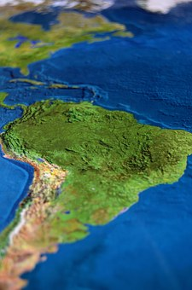


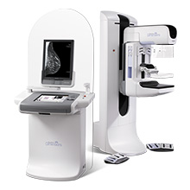
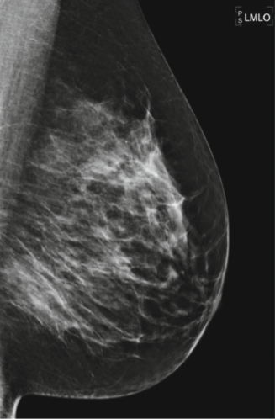
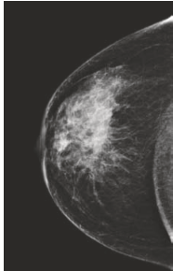

Motivation
Open-source
Third world countries
18.000$
CAD software
clinical interpretation
benign
malign
Medical training as primordial factor

Slide 5
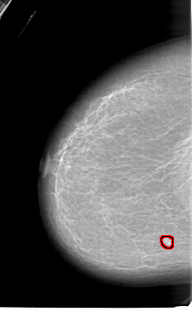
1.1 data bases
http://peipa.essex.ac.uk/info/mias.html
http://marathon.csee.usf.edu/Mammography/Database.html
Mini-MIAS database of mammograms
Regular quality
Reduced Quality and size of Images
University of South Florida Digital Mammography
Better quality
Image classification by radiology assessment
LJPEG 42 microns
From 2500x4000 to 1024x1024 pixels

Slide 6
1.1data bases
MIAS
Image format compatibility with regular sw
Difficult accessibility, lot of forms to sign
DDSM
Specified Overlay and radiology diagnosis assessment specifying the type of view (ML, MLO, CC)
The images come from several analog screening tests and then digitalized.
Less artifacts and noise
Better axial resolution and depth 12 bits/pixel
Smaller image size and depth (8bits)
Doesn’t have overlays complicating the segmentation accuracy verification process
Several artifacts as labels, and noise
A Non-Standard format so in order to preview the image it is needed a special software.

Slide 7
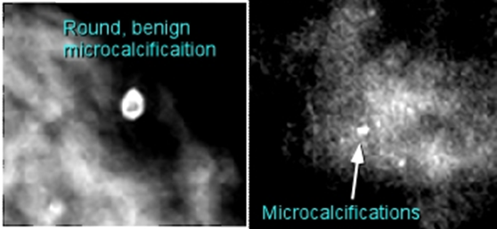
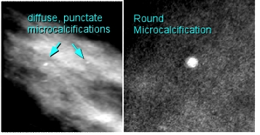
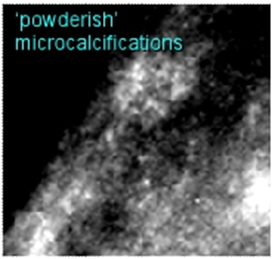
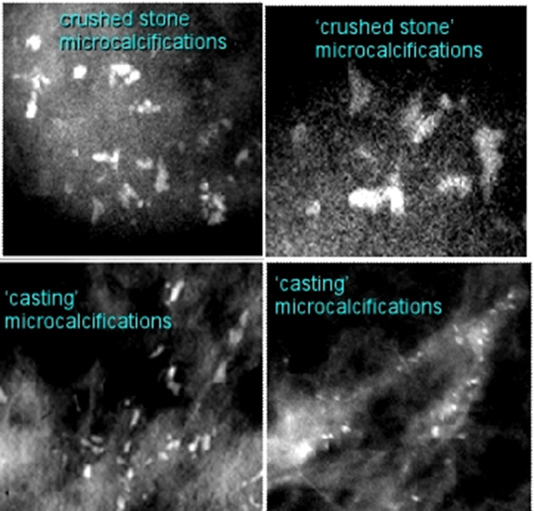
1.2. BI- RADS Breast Imaging Reporting and Data System
examples
1. Negative
2. Benign findings
3. Probably benign
0. Incomplete
4. Suspicious abnormality
5. Highly suspicious malignancy
6. Known biopsy with proven malignancy
Circumscribed, low density core, architectural changes
3.
4.
Asymmetric, convex, pleomorphic, radio-opaque
5.
Several pleomorphic micro-calcifications, spiculated and non-circumscribed masses
Standardization and reliability
6.

Slide 8

1.3 Software structure
Structure
https://github.com/Adrizcorp/K-MAMM-CAD

Slide 9
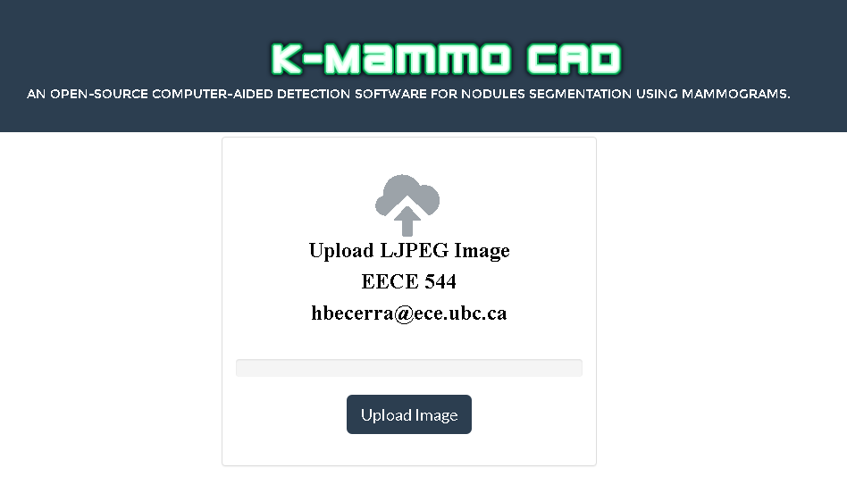
1.3 Software structure
interface

Slide 10
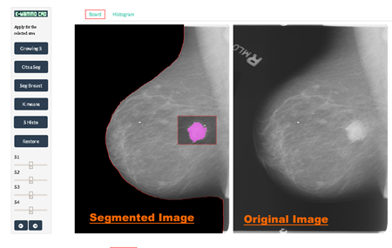
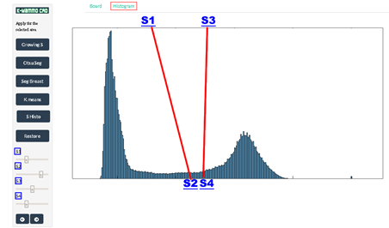
1.3 Software structure
interface
Seed growing segmentation, Otsu Segmentation using thresholding, Breast segmentation in base of Otsu method and sobel edge detection, thresholding segmentation using the histogram of an specific region or the whole image, and K-Means segmentation.

Slide 11
2. Techniques and results

Slide 12
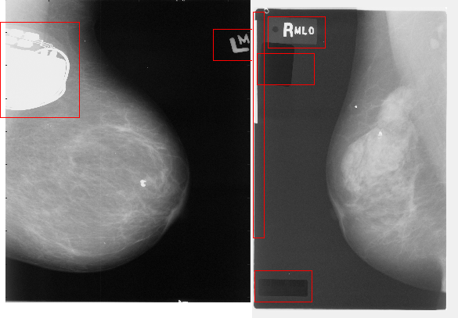
2. Techniques and results
DDSM data base is characterized for having lots of artifacts within the images such as labels.

Slide 13

2.1. LJPEG visualization and decompression
All the images are compressed in the Lossless JPEG format.

Slide 14
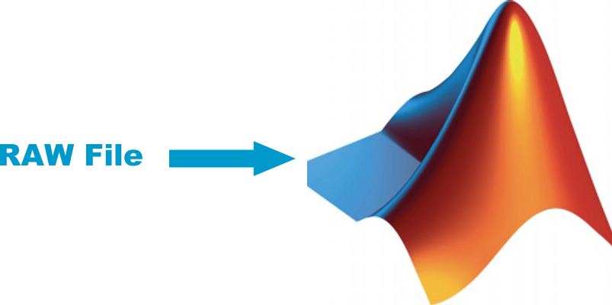
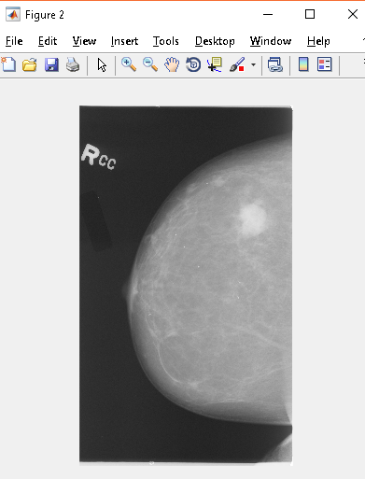
2.1. LJPEG visualization and decompression

Slide 15
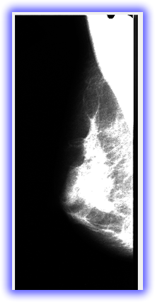
2.1. LJPEG visualization and decompression
Saturation, and not Open Source :/

Slide 16
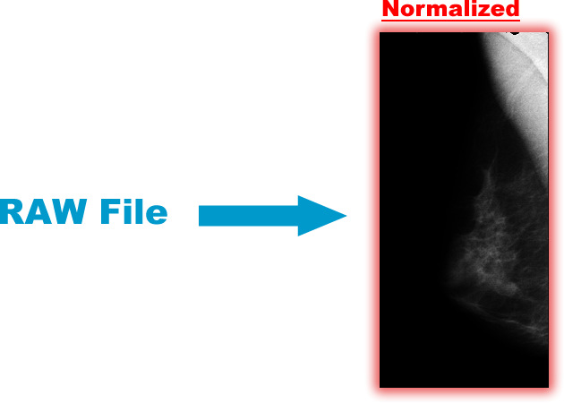
2.1. LJPEG visualization and decompression
Algorithm to normalize the intensities of the image, and Convert the image to compatible format.

Slide 17
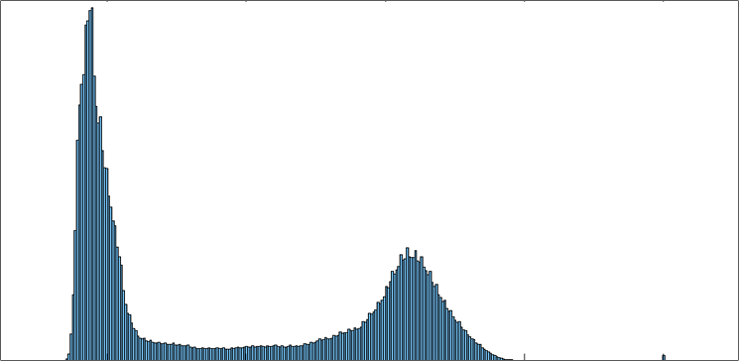
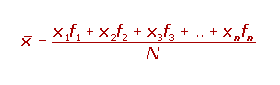
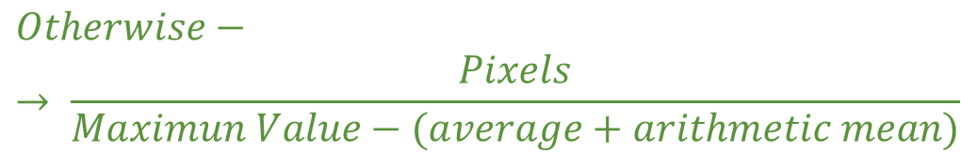

2.1. LJPEG visualization and decompression
$$If Log2\left(Maximum Value\right)−→ \frac{Pixels}{Maximun Value}$$
$$Otherwise−→ \frac{Pixels}{Maximun Value−(average+arithmetic mean)}$$

Slide 18
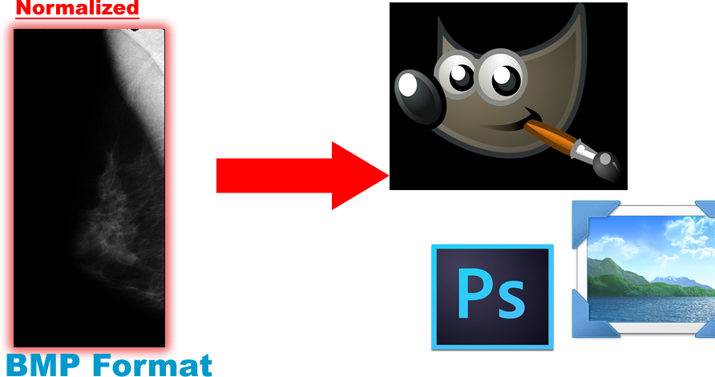
2.1. LJPEG visualization and decompression

Slide 19

2.1. LJPEG visualization and decompression

Slide 20
2.2. Breast segmentation

Slide 21
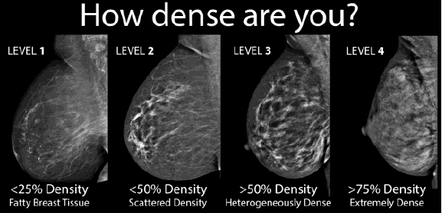
2.2. Breast segmentation(WHY?)
1)To reduce the amount of information, remove labels.
2)The higher density the harder to distinguish the nodule.

Slide 22
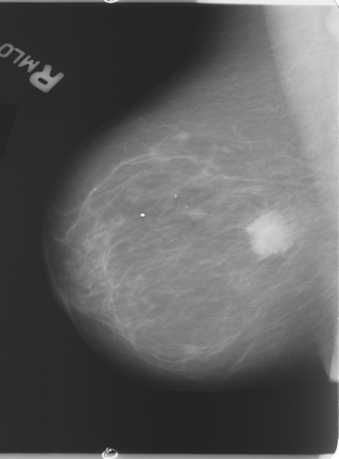
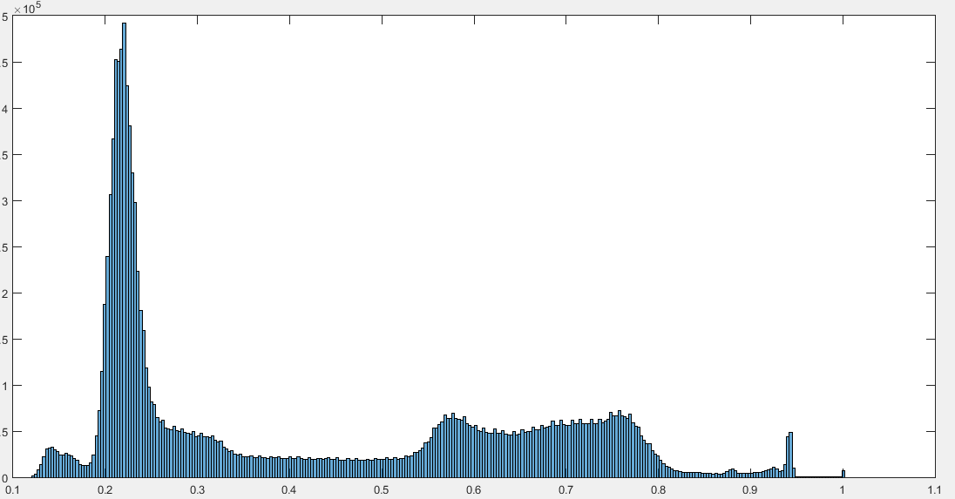
2.2.1. Otsu Method(OPTIMAL THRESHOLD)
Heuristic
Way?

Slide 23
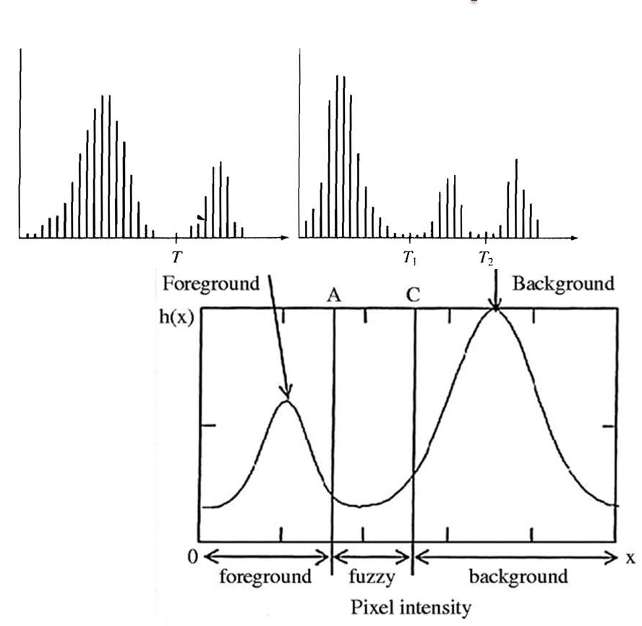
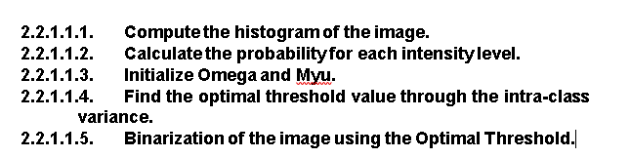
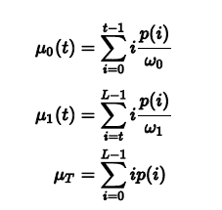
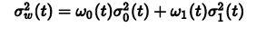
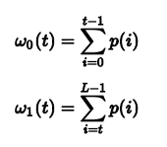
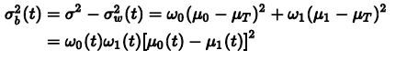
2.2.1. Otsu Method (OPTIMAL THRESHOLD)

Slide 24
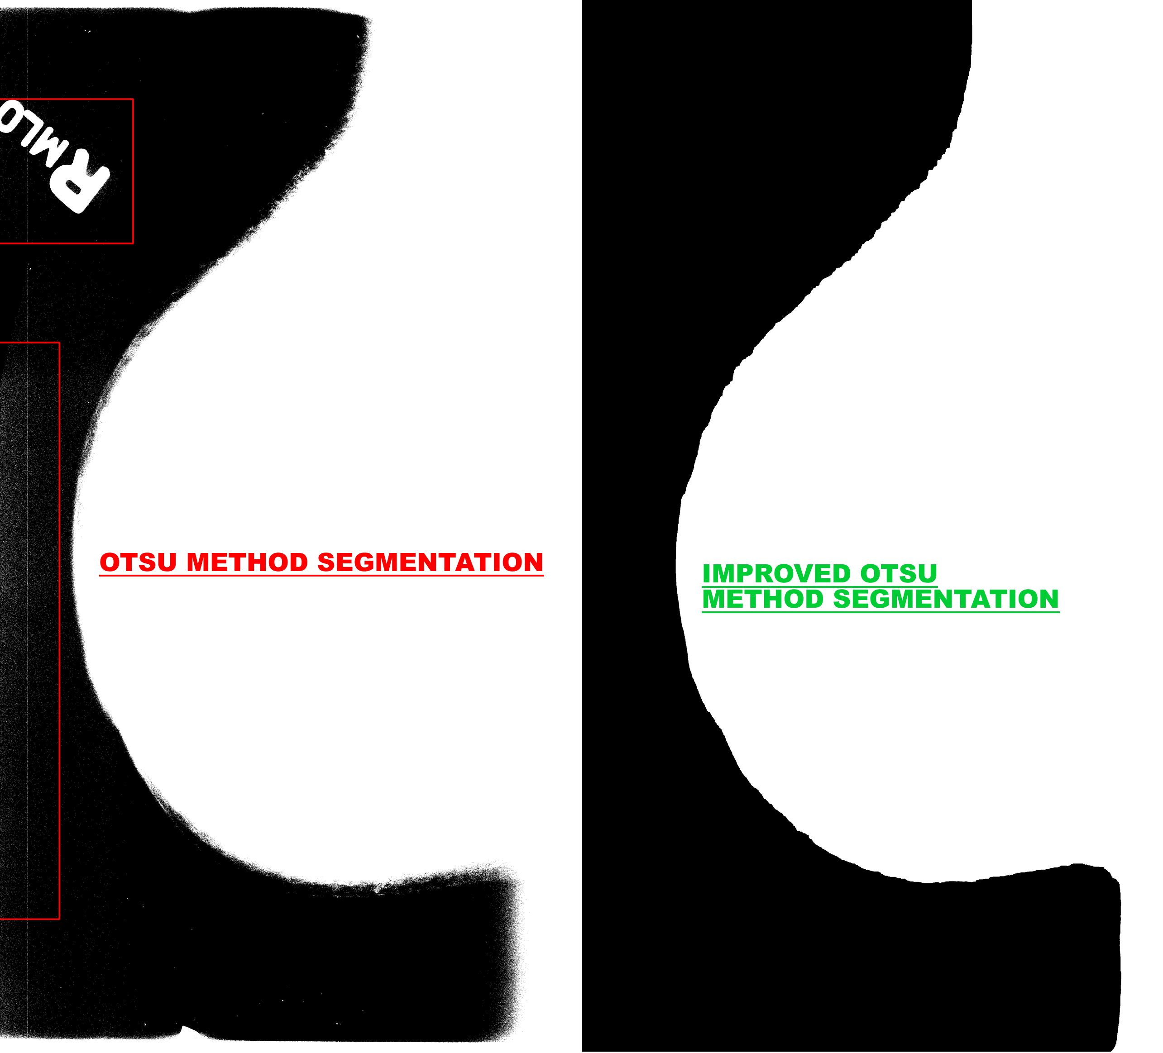
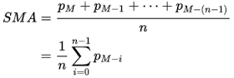
2.2.2.Average Filter
Moving Average Filter

Slide 25
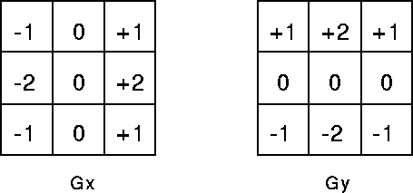
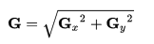

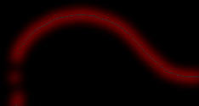
2.2.3. Edge Detection
Sobel Gradient Magnitude
Sobel Operator

Slide 26
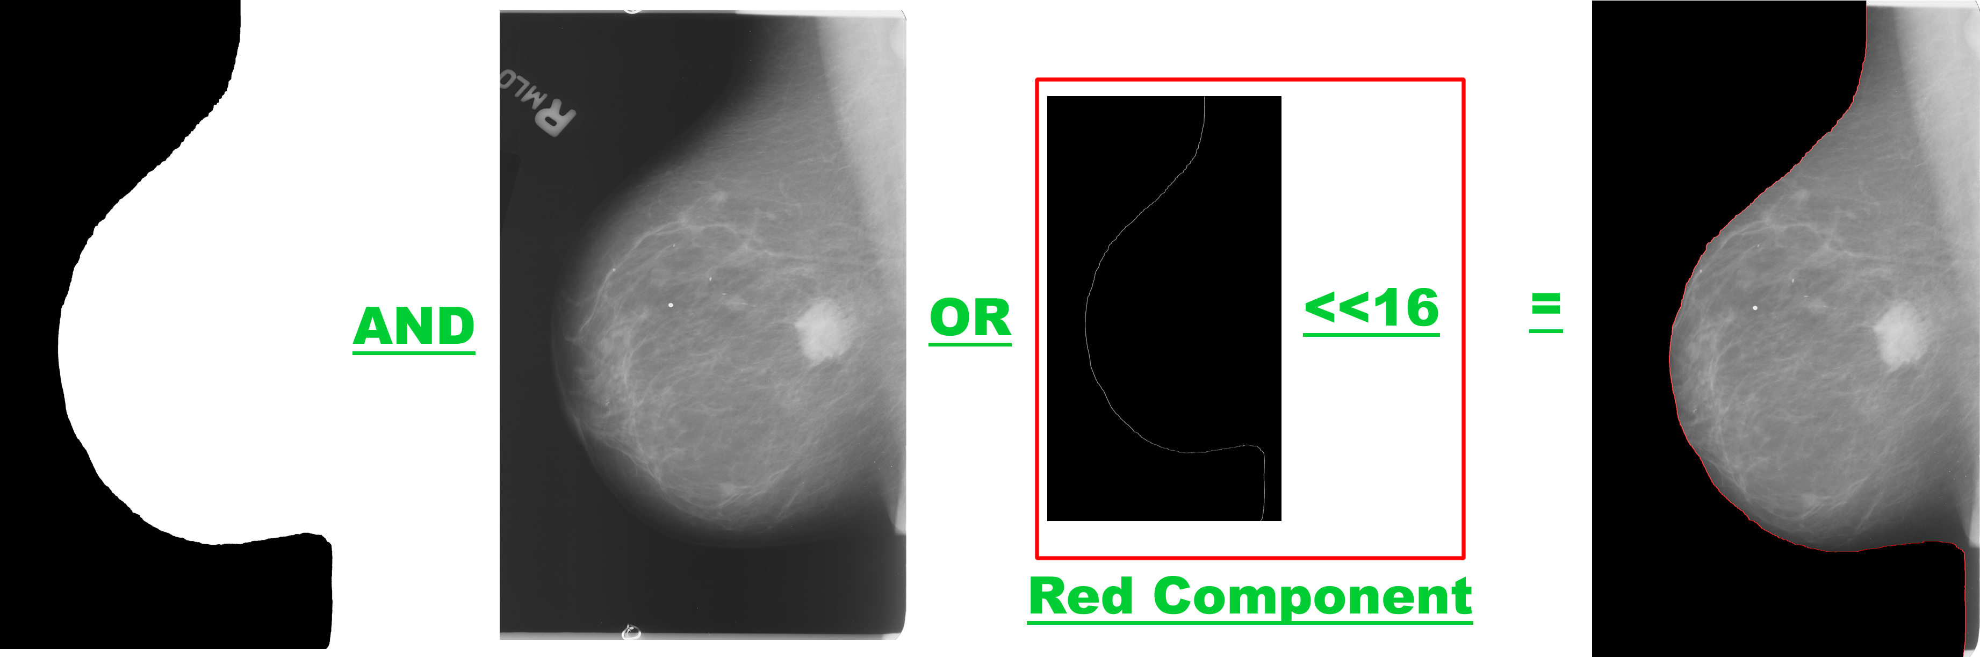
2.2.4. Digital Operations

Slide 27
2.3. Mass Segmentation

Slide 28
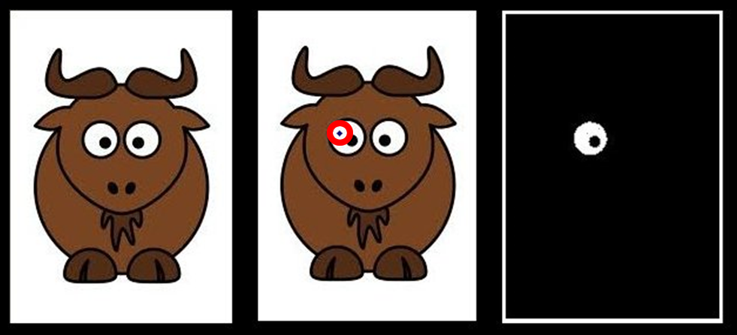
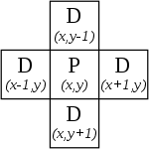
2.3.1. Region Growing Algorithm

Slide 29
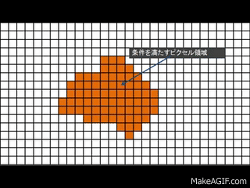
2.3.1. Region Growing Algorithm

Slide 30
2.3.1. Region Growing Algorithm
This algorithm examines an initial kernel of pixel which is called the seed points, this seed is compared with its neighbors (pixels around) to determine whether or not the pixel belongs to the region of interest. This algorithm it is an intensive and iterative method to extract similar parts of an image. This region grows until this is block by the stop criteria, which in this case it is the difference between the outside(contour) pixel’s intensity and the region’s mean, then the minimum difference of the mean and the contour pixel is compared with a threshold, and if this difference is greater than a given thresholds, the algorithms stops. Otherwise the pixels are added to a mask (other image with the same size area of the original initialized with 0s).

Slide 31
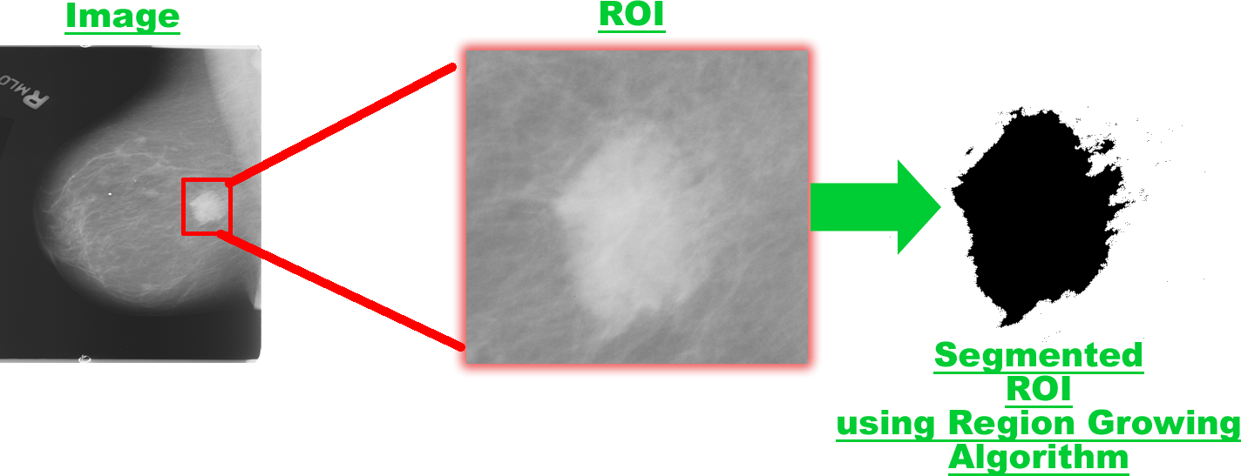
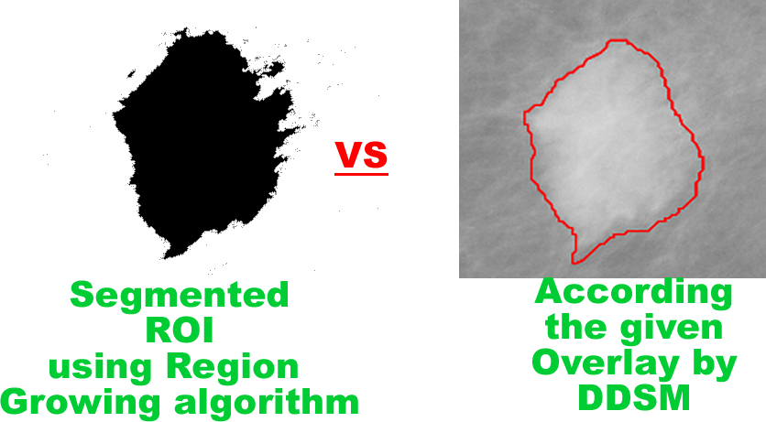
2.3.1. Region Growing Algorithm
Comparison between Region Growing and the Given overlay by the Database for the Image, B_3084_1.RIGHT_MLO.

Slide 32
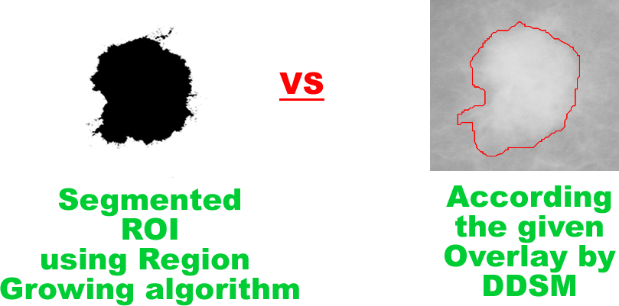
2.3.1. Region Growing Algorithm
Comparison between Region Growing and the Given overlay by the Database for the Image, B_3084_1.RIGHT_CC

Slide 33
Conclusions

Slide 34
As a first conclusion, in base of the obtained results, is that there is a considerably number of other methods that could be applied, and wanted to be applied in the project, but for the time it was not possible, such as the K-Means Segmentation, masses classification extracting morphological features that can help the radiologist determine the type of mass (benign, malign), these features could be extracted in base of these first results using mathematical models, Autoencoder or Deep Neural networks. As a first version of a CAD tool, it can be said that the obtained results are satisfying, it is a start that can springboard a new generation of Open-Source CAD tools with the main objective of assisting radiologist to identify the different kinds of masses and its shapes. The project still has a lot work to do, and the help of lot of people that might be interested in continue this work, as I am. All the implemented methods show that the variation of the threshold, a good selection and interpretation of the intensities, it is crucial to perform a good segmentation, and get better results. The constant research in this area and development could take this CAD tool to get better results in the future.

Slide 35
BIBLIOGRAPHY

Slide 36
[1]"SEGMENTATION OF BREAST CANCER MASS IN MAMMOGRAMS AND DETECTION USING MAGNETIC RESONANCE IMAGING". [Online]. Available: http://www3.ntu.edu.sg/eee/urop/Congress2003/.../yao%20yao.pdf. [Accessed: 06- Oct- 2016].
[2] J. Block, "Digital Mammography Equipment Price/Cost Info [2016 Update]", Info.blockimaging.com, 2016. [Online]. Available: https://info.blockimaging.com/bid/95356/digital-mammography-equipment-price-cost-info. [Accessed: 06- Oct- 2016].
[3] "CAD for Mammography: Importance of Computer Aided Detection (CAD) In Treatment", Radiology-info.org, 2016. [Online]. Available: http://www.radiology-info.org/computer-aided-detection.html. [Accessed: 06- Oct- 2016].
[4]"Construcción de una base de datos de imágenes de mamografía para la identificación de microcalcificaciones", Repositorio.utp.edu.co, 2016. [Online]. Available: http://repositorio.utp.edu.co/dspace/bitstream/handle/11059/4236/621367S232.pdf?sequence=1. [Accessed: 06- Oct- 2016].
[5]"http://www.sersc.org/journals/IJSIP/vol6_no1/2.pdf", 2013. [Online]. Available: http://www.sersc.org/journals/IJSIP/vol6_no1/2.pdf. [Accessed: 06- Oct- 2016].
[6]"Mammogram Image Features Extraction and Classification for Breast Cancer Detection.", International Research Journal of Engineering and Technology (IRJET), vol. 02, no. 07, 2015.
[7] S. Halls, "BI-RADS category scale 2 3 4 5 score", Breast Cancer - Moose and Doc, 2016. [Online]. Available: http://breast-cancer.ca/bi-rads/. [Accessed: 07- Nov- 2016].
[8] Hogg, Peter, Judith Kelly, and Claire Mercer. Digital Mammography: A Holistic Approach. 1st ed. Cham: Springer, 2015. Print.
[9] Quesson B, Sabel J, Boumna H, Dekker R, Lengrand-Lambert J. Automatic target recognition in synthetic aperture sonar images for autonomus mine hunting. TNO Defensive en Veiligheid, 10th European Conference on Underwater Acoustics. 2010;.
[10] Wilson, Joseph N.; Ritter, Gerhard X. (2000), Handbook of Computer Vision Algorithms in Image Algebra (2nd ed.), CRC Press, p. 177, ISBN 9781420042382.

